Slide 1


Ferguson Township
Stormwater Advisory Committee
Meeting No. 5
Policy Discussions
Variability in Services
Introduction to Credit Options
Phase II
Stormwater User Fee Feasibility Study
August 7, 2019

Slide 2
Agenda
Welcome and Introductions
Policy discussion:
Methods to address variability in impervious area and stormwater related service across the Township (service zones)
Introduction to credit policy options
Discussion/Conclusions
TITLE PLACEHOLDERS

Slide 3
Methods to Address Variability in Impervious Area and Stormwater-Related Service Across the Township (Service Zones)

Slide 4
Feedback – July 17
  It is important that the cost model is capable of assigning costs by the infrastructure served.
    Service areas in Ferguson have a historical expense that can be aligned to a rate methodology, and the rate can be established on this methodology.
  The routine 'overhead' costs should be shared across service areas.
  It was noted that property owners in the service area with lower LOS based on the stormwater infrastructure do utilize the Township stormwater system found in the higher-level service area.
    It was noted that consideration should be given to an allocation of a minimal portion of the high-service area costs to all property owners.
    A 10 percent share was suggested.
  It was suggested that the Township minimize complexity and evaluate effectiveness after a few years of operation to see if the concepts of increased equity hold.

Slide 5
Variability in IA - Approach to User Fee Development
Recognizing Service variability within Township driven by infrastructure:
Complex systems of pipes, basins, inlets, swales, streams
Base-level systems of open channels and ditches and cross-drainage pipe under roadways
Interconnections to other systems (PennDOT roadways)
Other MS4 permittees within Township

Slide 6
By Rate Structure
Two-Element Rate Structure
Baseline Services: Serves all properties in Township
  Base cost to address administration and other services
Infrastructure management costs (operation, maintenance and capital costs):
  by geographic areas;
  type of infrastructure; or
  other parameter

Slide 7
By Infrastructure Complexity
Service Area 1 – higher frequency and level of service
Any lot that fronts on a Township street segment that has 50% or more of that street segment with a parallel storm pipe; or
Any lot that fronts on a Township street segment that has 50% or more of a street segment with curb on one or both sides.
Service Area 2 – lower frequency and level of service
Any lot that fronts on a Township street segment that is not in the Service Area 1; or
Any lot that fronts on a street owned by another MS4 permittee, or a private street; or
Any lot that is covered by a separate MS4 Permit with DEP.
Each service area has about 24,000,000 square feet of impervious area.

Slide 9
Cost Alignment in Service Areas
ALL:
Program management, system planning, overhead, and Township MS4 compliance (including capital required to comply with the Township’s Pollution Reduction Plan)
Service Area 1: High Level
Operations and maintenance for underground and above ground drainage infrastructure and capital improvements
  pipe lining,
  new equipment purchases,
  system inventory update
  drainage system assessment
  This service area also has costs assigned for a new foreman and three-person crew added over the five-year period.
Service Area 2: Low Level
Operations and maintenance of roadway ditch and cross-pipe maintenance.
No capital projects were included in the first five-year program plan.

Slide 10
Discussion
Is it appropriate to set a base cost per account? (e.g., Adm, Overhead, Public Ed)
What approach will make sense to the public?
  Variable rates – density of development + impervious area
  Service Areas based on type of infrastructure
  Service Areas based on density of population
  Service Areas based on geographic boundary

Slide 11
Discussion Questions
Should the MS4 program and MS4 capital costs be assigned to all properties?
Should program administration costs be assigned to all properties?
Property owners in Service Area 2 benefit from the investment in and maintenance of the drainage system in Service Area 1. Should some portion of the costs of operation and maintenance for the Service Area 1 system be assigned to the Service Area 2 cost allocation?
Should capital projects for new treatment facilities/quantity controls be a shared cost for Service Area 1 or should these costs be assigned/recovered only to those properties directly served? This could be done through the assessment process, rather than through the rate structure.

Slide 12
Cost Center | Fixed Cost – All Pay | Planning and MS4 – All Pay | Service Area 1 | Service Area 2 | Roadway Projects w/drainage by TIF
Administration
Township Overhead
MS4 Permit – Ops
MS4 Permit – CIP
Planning Studies
Regulatory Enforcement
Inspection – Ditches/Cross Pipes
Inspection – Pipes, Inlets, Basins, GI, Channels
Pipe Relining
System Maintenance
CIP

Slide 13
Credit Policy Introduction

Slide 14
Discussion Questions On Credit Policy Development
What is a credit?
  A credit is a reduction in total utility fee charged a specific owner of a parcel, based on policy established by the Board of Supervisors
Are credits mandatory?
  No, in PA credits are a discretionary action by the Township
What are the financial implications to the Utility of a credit program?
  Personnel time to administer (approve, review, enforce)
  Impacts on the rate structure – reduces individual revenue from a parcel; not necessarily reducing program costs
Who should be eligible?
  Depends on the type of credit adopted
  Credits are earned; not awarded

Slide 15
Discussion Questions on Credit Policy Development
How and when will credits be available?
  Once a year billing – by what date should credits be applied for by property owner?
  If an owner misses a date for application, should the Township grant a credit between billing periods?
If a facility treats runoff from offsite impervious area should the credit be calculated on total IA served?
  If yes, how to handle the credit should offsite property have treatment installed?
Is there a limit to the amount of credit that can be earned?
  Most credit programs are adopted with a limit to the value of the credit.
  Most credit program are aligned to the services provided by the local jurisdiction.
How is the credit for a structural facility calculated?
  Facility only handles ½ of site impervious area runoff.
  Facility treats offsite impervious area runoff.

Slide 16
Factors Considered - How Credits are Applied
Credit for a BMP built voluntarily that exceeds Township SWM standards.
BMP built according to current Township SWM standards – lesser value.
Ratio of impervious to pervious surface may result in less site runoff
Participation in watershed stewardship activities.
Public education institutions that provide water quality education to students – high school science curriculum module.
Residential rain barrel programs.
Impervious area reduction – removal of IA.
Implementation of nutrient management plans.

Slide 17
Attributes
Voluntary or Required by Development Standards
Structural or Nonstructural
Reduces Township Costs or Value-driven such Public Education
Residential or Non-residential
Apply or Automatically Granted
MS4 Permittee such as Industrial NPDES Discharges
Enforcement
  By Township
  Self-certification of functionality

Slide 18
Purpose of Credits
  Acknowledges that on-site GSI can reduce the long-term cost of public stormwater services.
  A credit is not a reimbursement program – it is a way to acknowledge the future public benefits of operating a facility, not to reimburse owners for past investments.

Slide 19
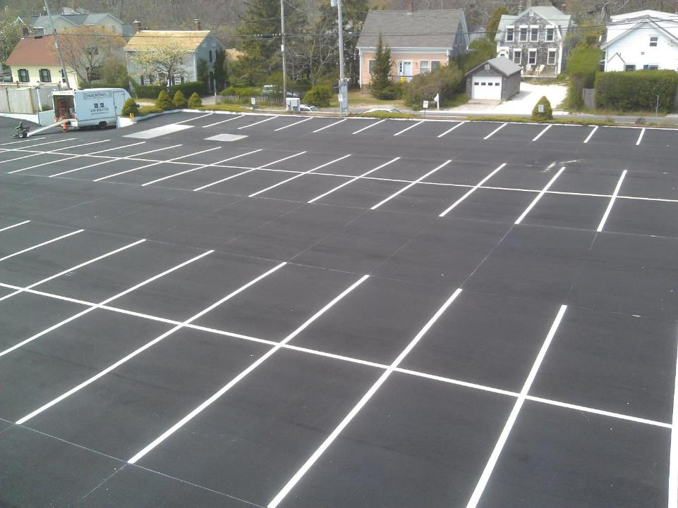
Notes:
In other words, how do we acknowledge that the owner of the above property has a greater impact, and should therefore pay more, than the property owner on the next page – even if they have similar impervious cover.

Slide 20
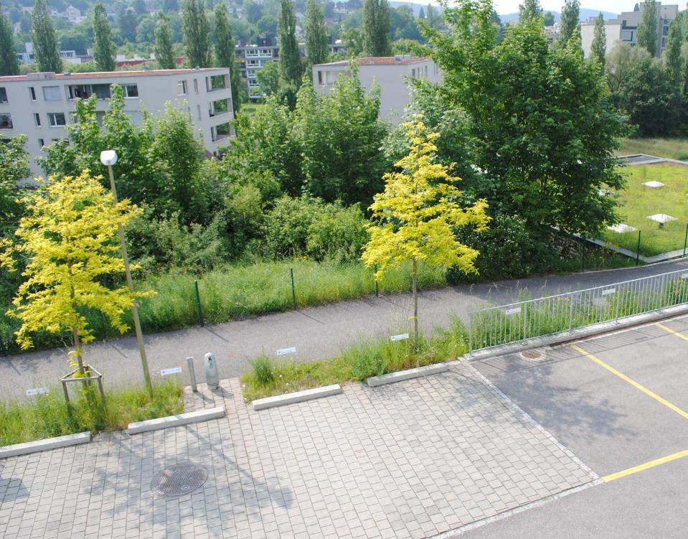

Slide 21
Credit Systems
  Credit systems can be very simple – reactively recognize investments made by property owners.
  To more complicated – designed to incentivize voluntary installation of GSI or enhancements made to an already required GSI.
  Regardless, there must be a verifiable benefit. A stormwater utility is a fee for service.
Notes:
There are a wide range of ways to structure the credit system depending on local goals and objectives.

Slide 22
Who should is eligible for credit? Allentown PA
The City will provide a stormwater utility fee credit for:
any stormwater management facility,
whether built voluntarily or as a condition-of-development,
installed on or after April 19, 2007 for quality purposes (the adoption date of “The City of Allentown’s (Act 167) Stormwater Management Ordinance,” Article 1387 of the City Code), and/or
installed to control volume in accordance with Article 1387 or it predecessor requirements.

Slide 23
How much credit should be received?
Facility Type and Purpose | Base Credit Amount | Voluntary Facility Bonus | Total Possible Credit
Facilities Achieving 10% or More Sediment Reduction from Existing Conditions (Assumes That These Facilities Also Control Volume)
10% to <25% | 20% | 20% | 40%
25% to <75% | 25% |  | 45%
75%+ | 30% |  | 50%
All Other Facilities Built in Accordance with Article 1387 of the City Code, Regardless of Whether it is for Quality, Quantity, or Both
All | 10% | Not Applicable | 10%

Slide 24
Simple - Chesapeake, Virginia
  20% credit for water quality facility.
  20% credit for water quantity facility.
  Calculations must be submitted by a professional engineer.

Slide 25
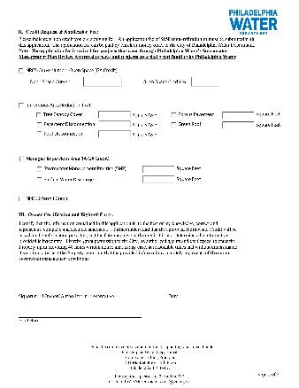
More Complicated – Philadelphia
  Open space credit.
  Impervious area reduction:
    Tree canopy
    Pavement and rooftop disconnection
    Porous pavement
    Green roof
  Managed impervious area.
  NPDES permit credit.

Slide 26
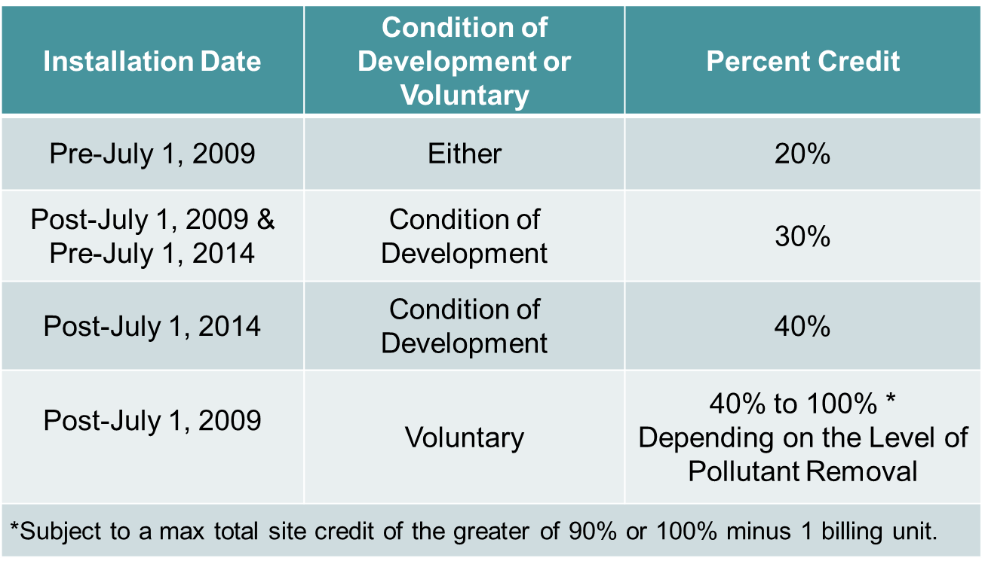
Very Complicated – Charlottesville, Virginia

Slide 27
Credit Impacts
  The public benefit is long-term, the short-term program needs remain the same.
  As a result, credits shift the burden of the short-term program to those who do not have credits.
  The impact of a credit on a specific property will depend on the amount of impervious cover.
Notes:
Regardless, credits do have impacts that we should be aware of.

Slide 28
Incentives – Not Credits but Partnerships
  Similar to a grant program.
  Used to assist owners to install or engage in practices that improve water quality.
  Two potential approaches:
    Target Driven. Allows staff to approach targets of opportunity that will help meet water quality and quantity control goals.
    Engagement Driven. Gives property owners a way to engage, with efficiency and accountability being only secondary goals.
  What is the right approach for the Township?
Notes:
In addition, there are also incentives – which are similar to a grant program. Many localities have both credits and incentives.

Slide 29
Discussion Questions on Credit Policy Development
What activities should be eligible for a credit?
  Onsite treatment and/or flow reduction attributes
  Public engagement (e.g., volunteers for stream cleanup; public education curriculum)
How much credit should be awarded for each activity?
  Facility classifications: built after 2003; before 2003; before any stormwater standards adopted
  Non-structural: activities support the goals and services provided by the Township
Should credits expire – require reapplication?
  As facility standards change in the future, should existing credits be renewed/reduced/sustained?
  As the program of services change, should credits be adjusted?
Should maintenance agreements be required for all structural facility credits?
  How should maintenance be verified
  How frequently should maintenance be verified

