Slide 1
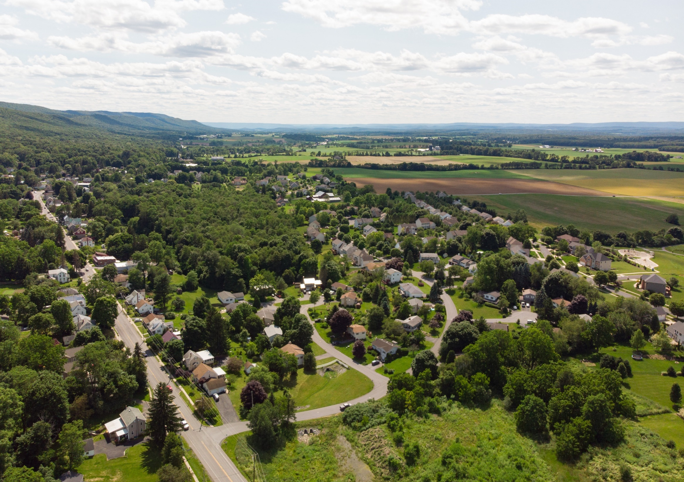
FERGUSON TOWNSHIP BOARD OF
SUPERVISORS
November 4, 2019
PINE GROVE MILLS
SMALL AREA PLAN

Slide 2
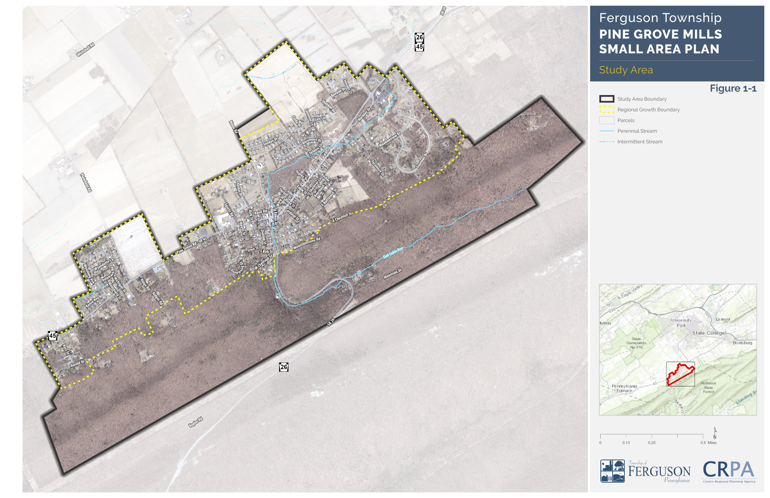

Slide 3
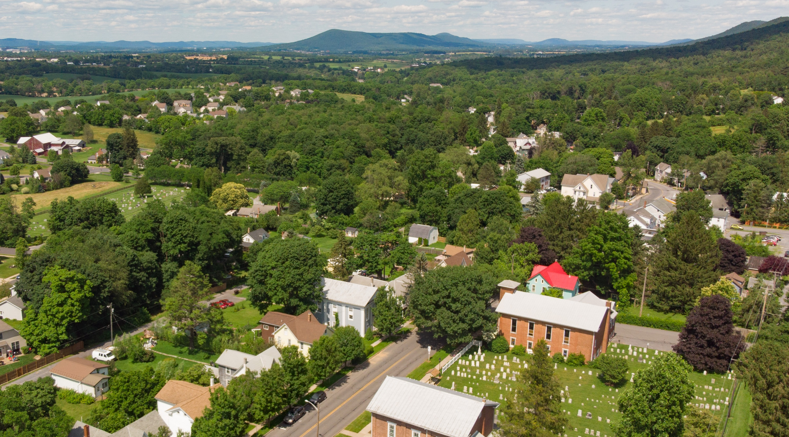
Vision Statement
The Pine Grove Mills Small Area Plan seeks to preserve the living heritage and values of the residents by providing an outline for improvements and development that strengthen connectivity, sense of community, safety, physical environment, commerce, and recreation within this unique and historic village.

Slide 4
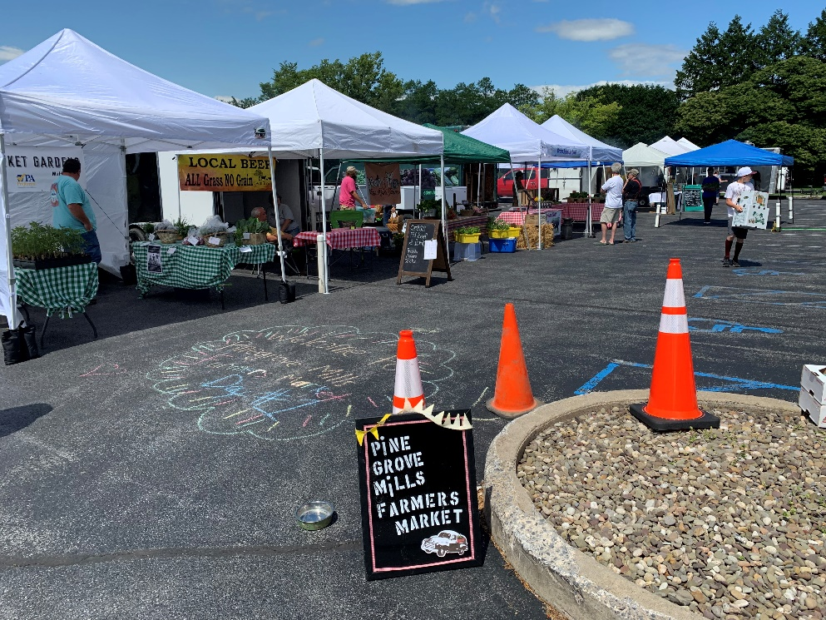
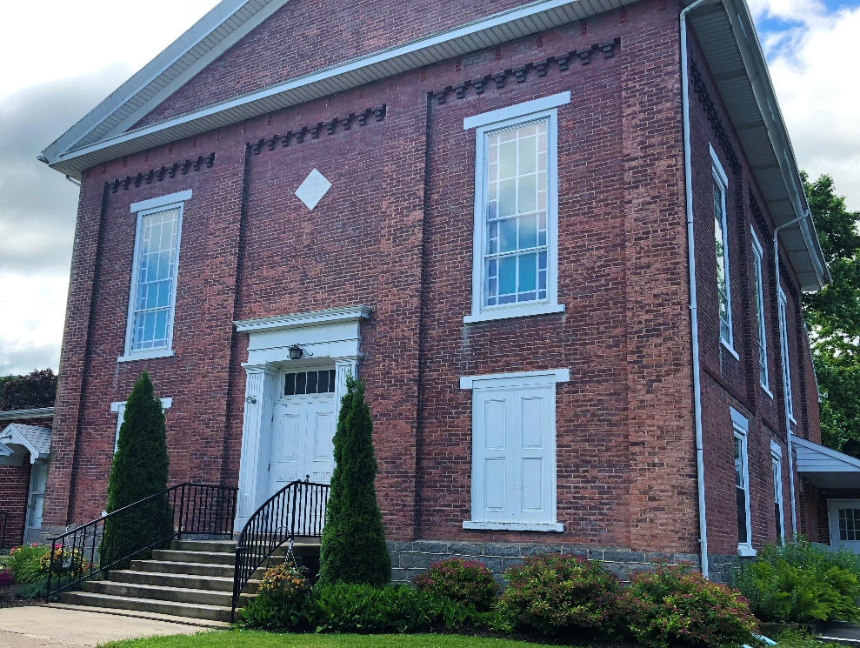
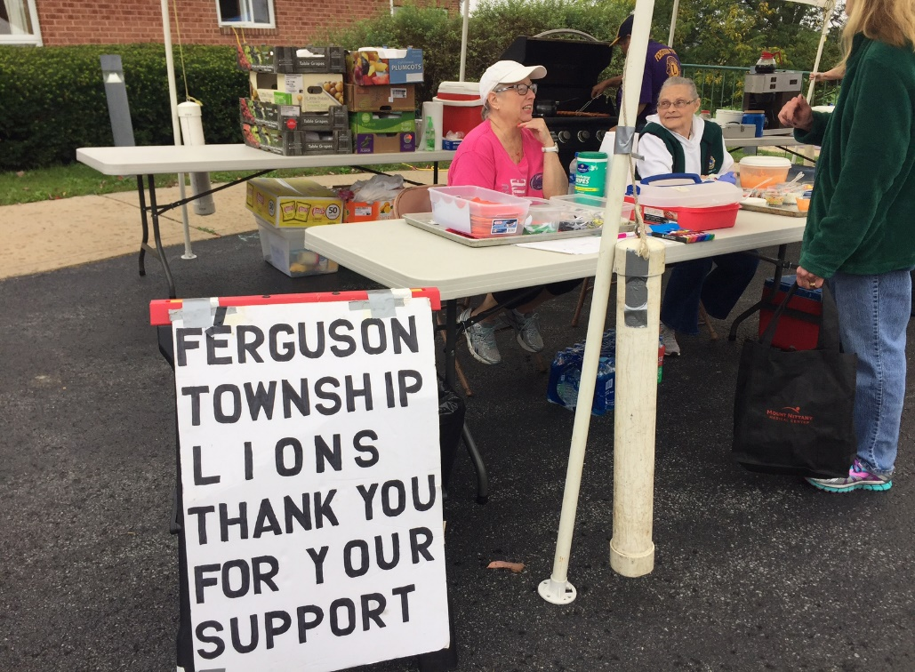
Strengthen PGM as a place that engages community
Improve advising of activities
Consider additional signs in PGM
Consider a community facility in Cecil Irvin Park
Improved parking in the Village for events that facilitates safe pedestrian movement
Fix gaps in sidewalks
Consider a complete street study

Slide 5
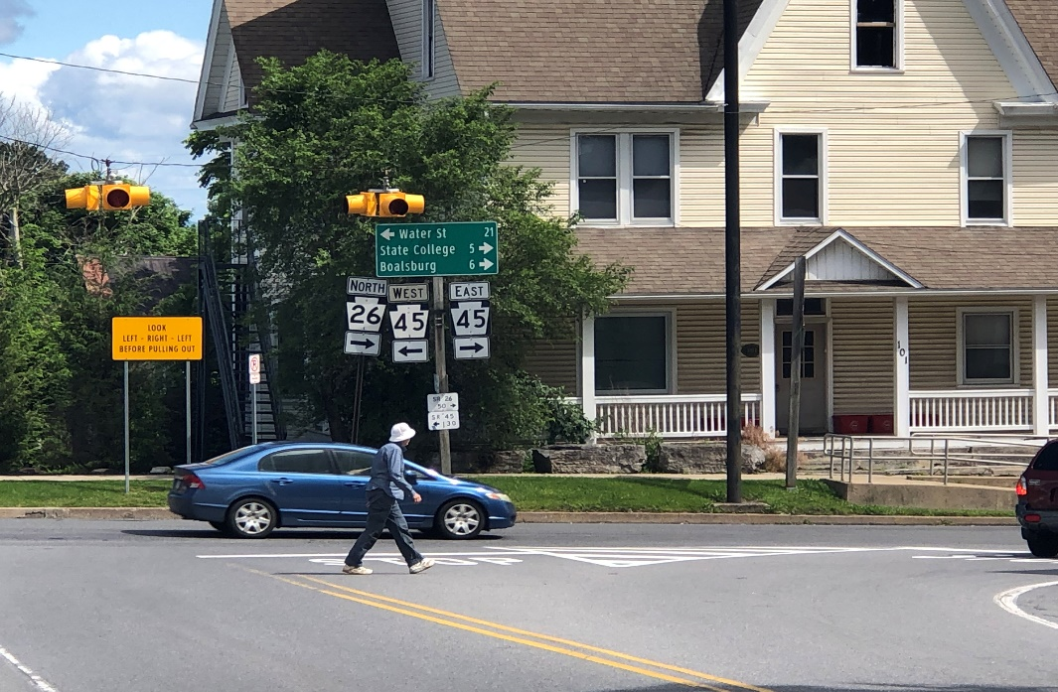
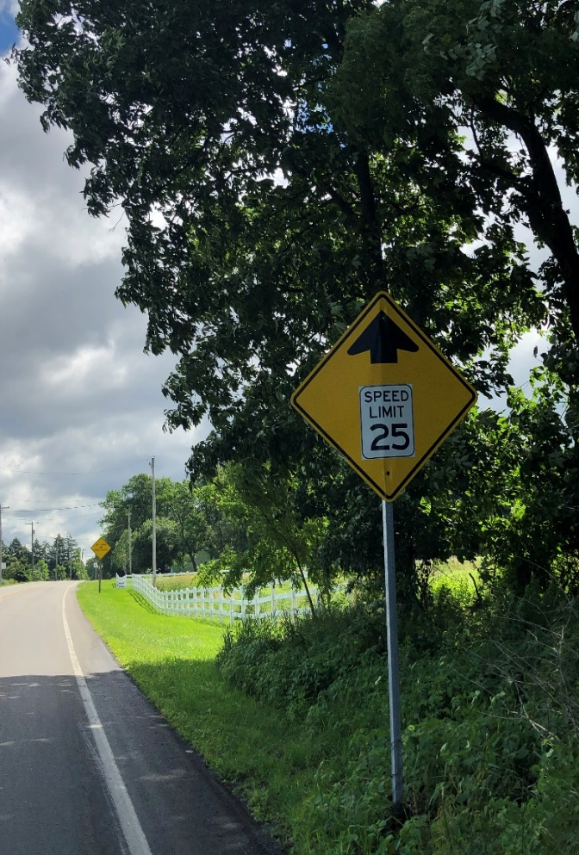
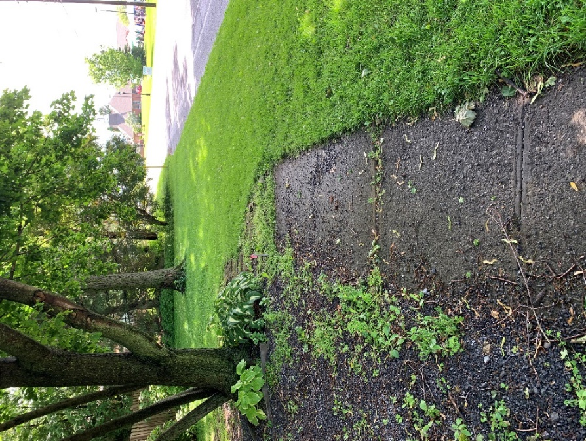
Improve Safety for Multiple Modes of Transportation
Lack of crosswalks
Speeding
Narrow shoulders
Lack of sidewalks
Blinking light intersection
Connection between neighborhoods - schools
Connection between neighborhoods – Village

Slide 6
Pine Grove Mills – A Vibrant Community
Small business development in the Village
Ordinances that support businesses…
Parking – Signs – Flexibility – Design
Tourism connections
Tourism connections
Recreation connections
Branding
Get people to stop in the Village
A place to hold community events

Slide 7
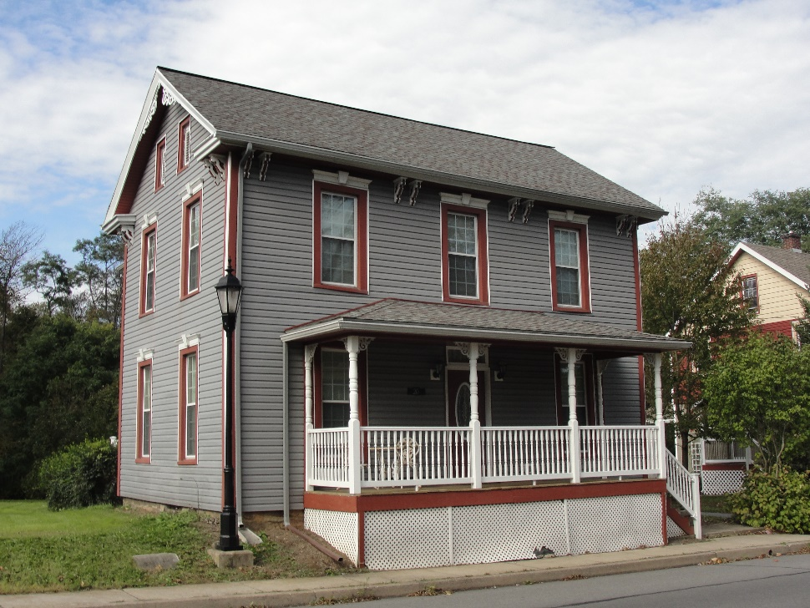
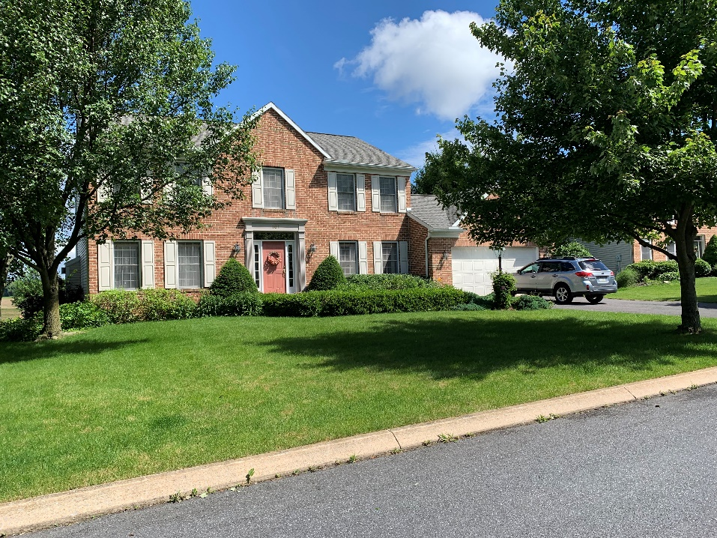
Embraces a Diversity of Neighborhoods
Define neighborhoods
Connectivity between neighborhoods
Historic signs
Safe pedestrian and bicycle connections

Slide 8
Pine Grove Mills History and Heritage
History is well documented
Need place to display and collaborate
Consider web page
Seek partnerships with others
Strengthen community partnerships
Seek funding to preserve documents
Connect history and local events
Recruit volunteers at events

Slide 9
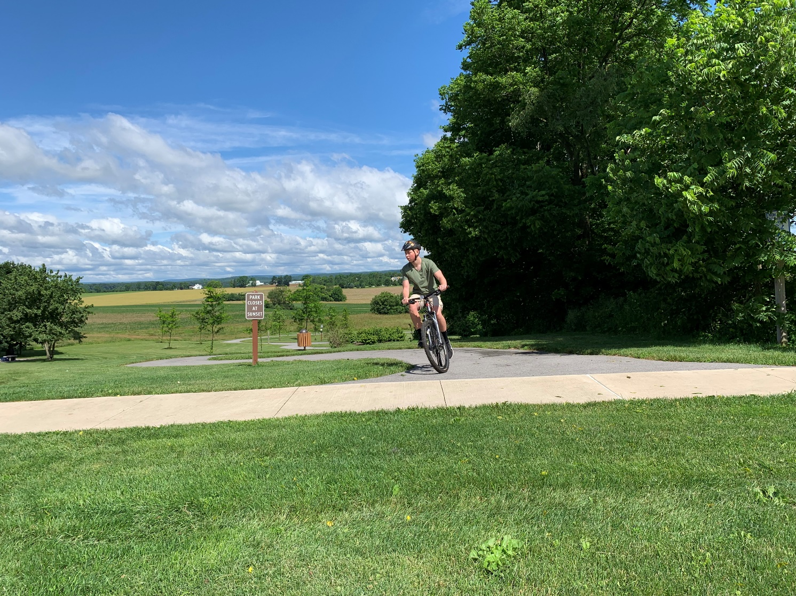
Recreation and Rothrock in Pine Grove Mills
Strengthen connections to Rothrock
Improve parking/access to trailheads
Improve signage and mapping
Improve bicycle connections in PGM
Improve bicycle connections to Scotia, Musser Gap, and into State College

Slide 10
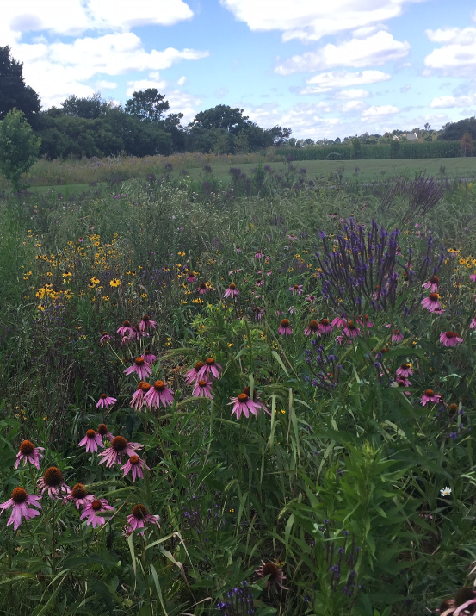
Community that values environmental stewardship
Increase awareness of natural resouces
Develop partnerships
Reduce community-wide impacts
Improve use of renewable energy
Protect the dark sky
Consider community-based solar

Slide 11
Community Participation
Monthly Meetings – St Paul Lutheran
Alignment Meeting – September 5, 2018
Town Hall – November 14, 2018
Community Survey
Township Web Page
CRPA Web Page
Township Facebook
CRPA Facebook

Slide 12
Implementation Strategy
Organize the Pine Grove Mills Community
Build community support by implementing attainable actions first
Active and regular engagement with Township Board, Commissions,
and Staff
Build partnerships and alliances to implement larger projects
Monitor and report implementation successes and needs on a regular basis

Slide 13
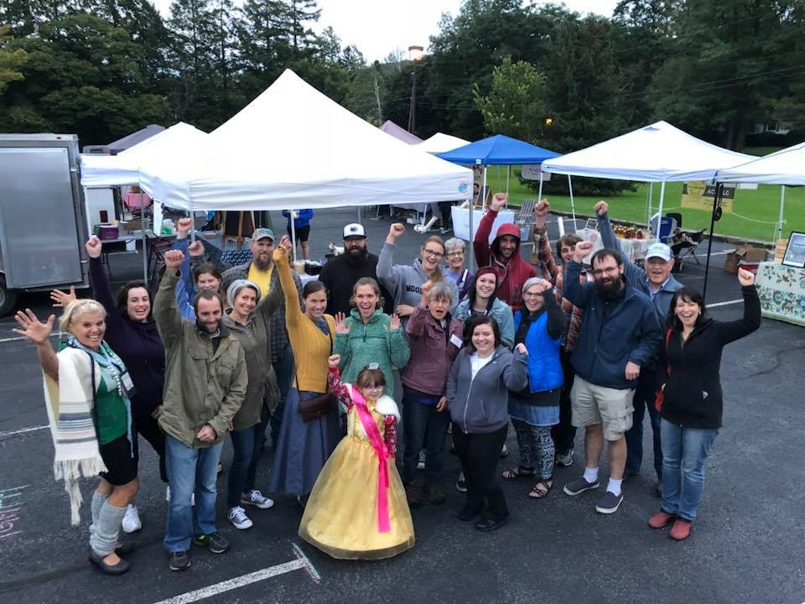
Next Steps
Photo: Laura Dininni

Slide 14
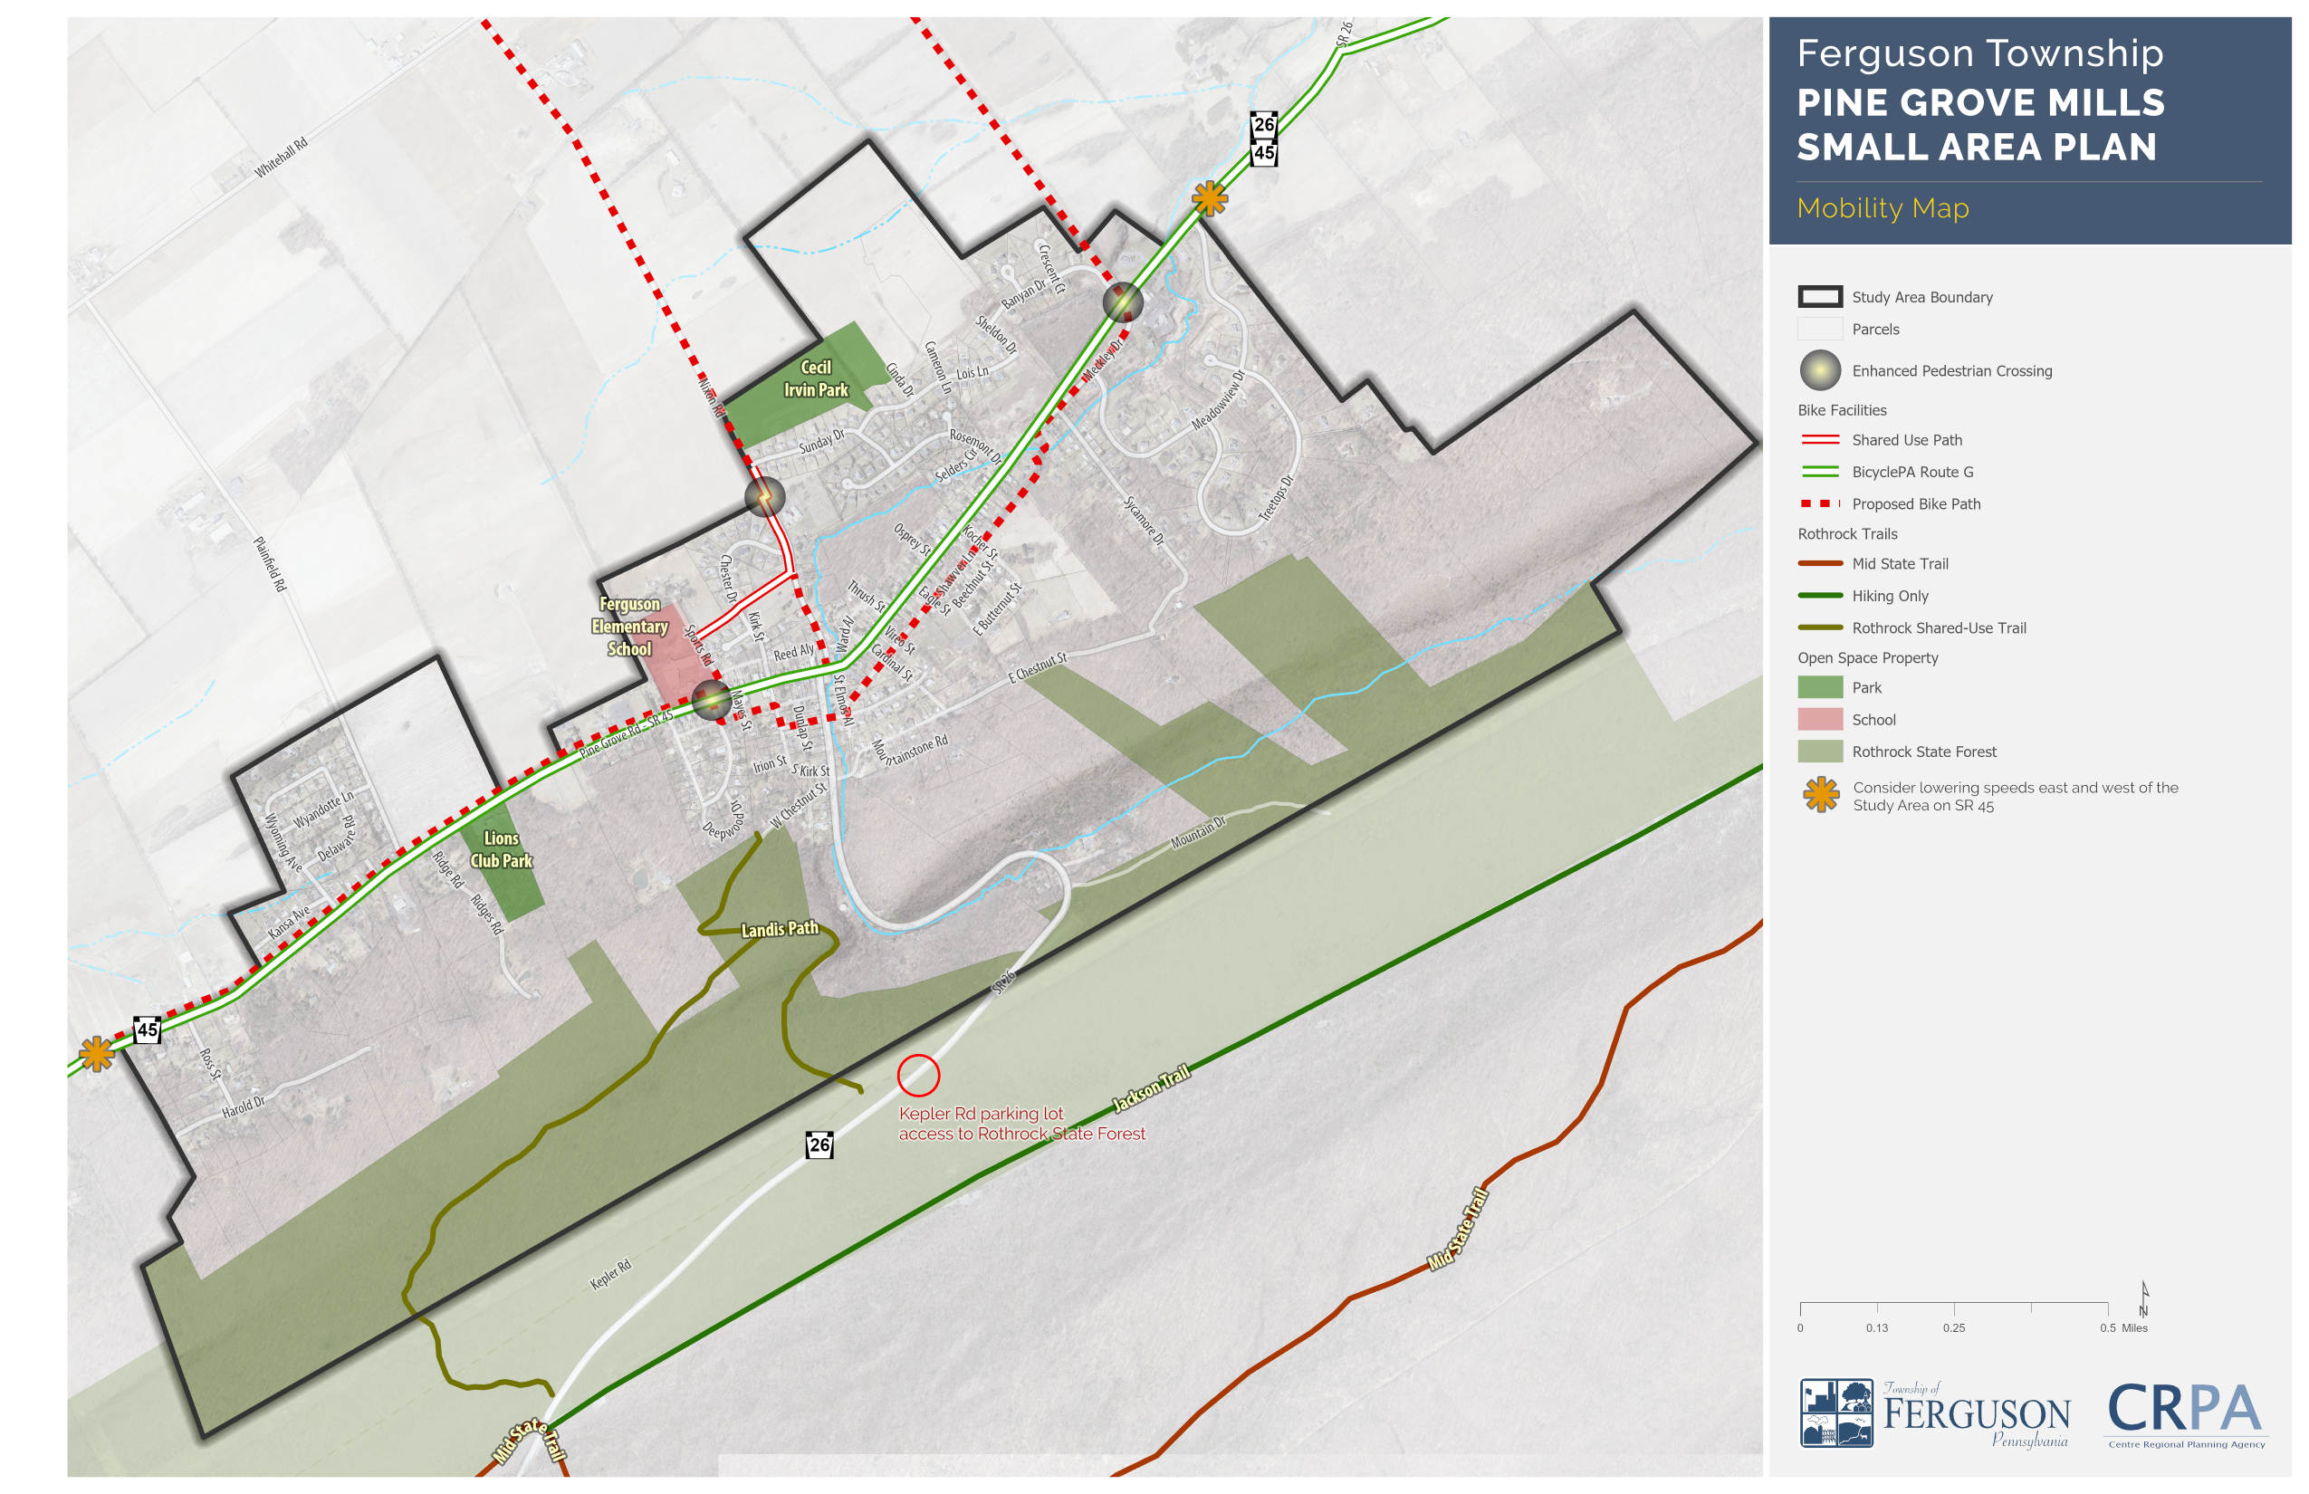

Slide 15
TOP TEN IMPLEMENTATION ACTIONS
Establish a community association to implement the Small Area Plan
Promote and coordinate community events
Amend sign ordinance
Prepare complete streets study for SR45 and SR26
Design and install traffic signal to replace “blinking light”
Improve mobility, particularly pedestrian and bicycle mobility
Determine what incentives would benefit local business recruitment and retention
Develop a zoning overlay district
Develop a list of Pine Grove Mills business contacts
Bury electrical lines to improve small town character

