Slide 1
Implementation of the Bicycle Facilities Plan In Ferguson Township
Kelly Beck, Matt Hall, Dan Millan, Shawn Chen

Slide 2
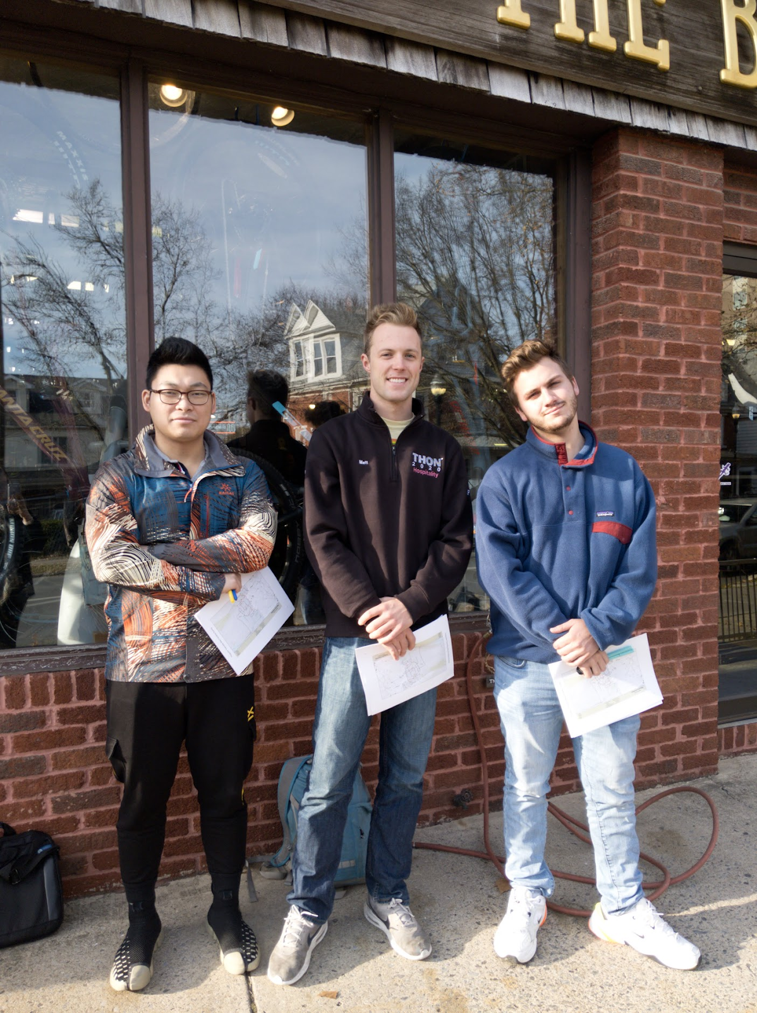
Who We Are
Community, Environment, and Development major, in the College of Ag Sciences
Completing our CED 475 Capstone Project
Backgrounds in planning, community engagement, survey implementation and stakeholder engagement

Slide 3
The Survey
Survey consisted of demographic and preference questions
Demographic questions were drawn from the 2015 Bike Facilities Survey
Question asked preference for where in the community they felt a need for a bike path
Completed on Qualtrics Survey Software, and through printed paper copies

Slide 4
Results
124 total responses were collected
97 participants responded and answered the survey completely
32 women and 62 men, with 3 undisclosed
57% of respondents from Ferguson Township

Slide 5
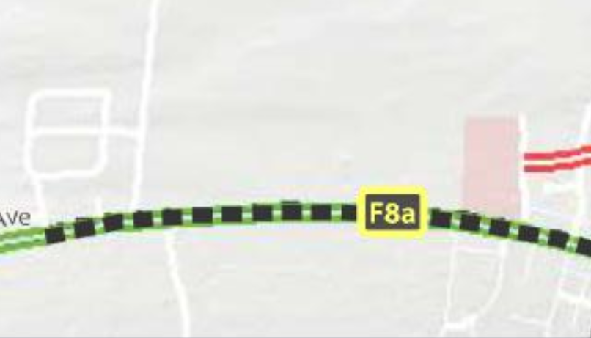
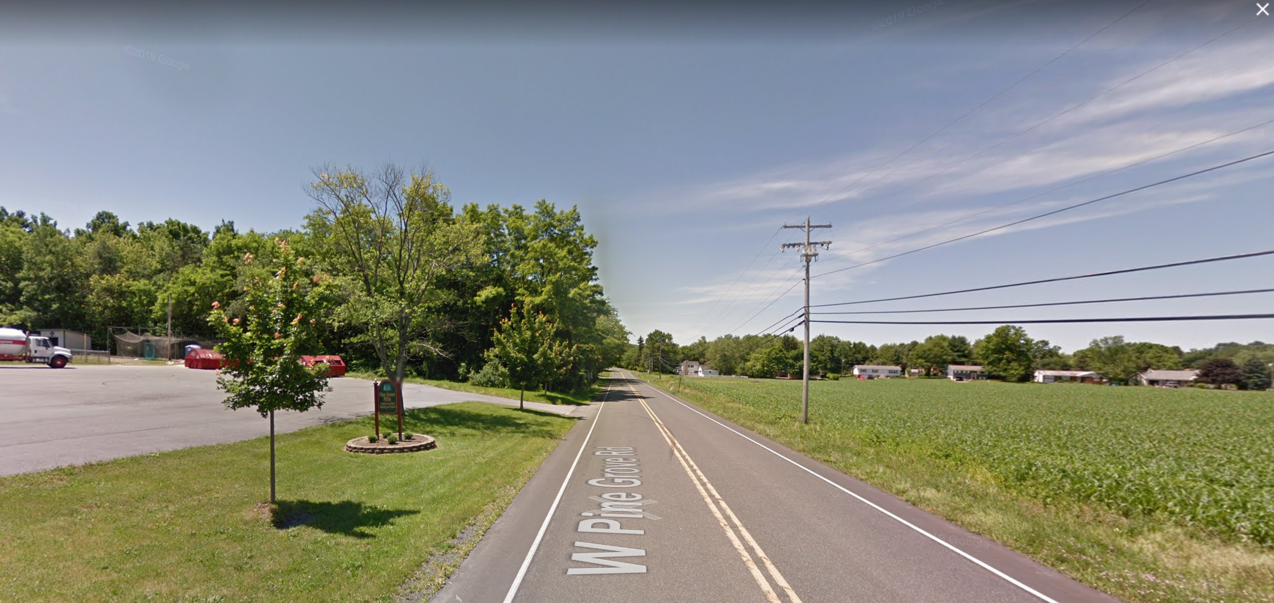
Preferences of Constituents
Most cited bike path/ path area was the proposed round along W Pine Grove Road
Cited safety concerns and the lack of any bike path along the road
Concerns expressed in survey showed a lack of concern for bikers by motorists
Connections to the central bike paths was cited as a major concern

Slide 6
Other Preferences
Participants expressed an interest in separate paths, and dislike for bike paths on roadways
Cited safety concerns
Expressed interest in bike paths along with future development of natural gas pipelines or other infrastructure construction
Other spaces not currently apart of the bike plan included Musser Gap connections

Slide 7
Remarks
Survey covered a large participant size, but a majority from the township
Preferences were clear and showed a genuine interest from the biking community in the region in the proposed paths
Further discussion is needed, so that the COG has access to the most recent township map

