Slide 1
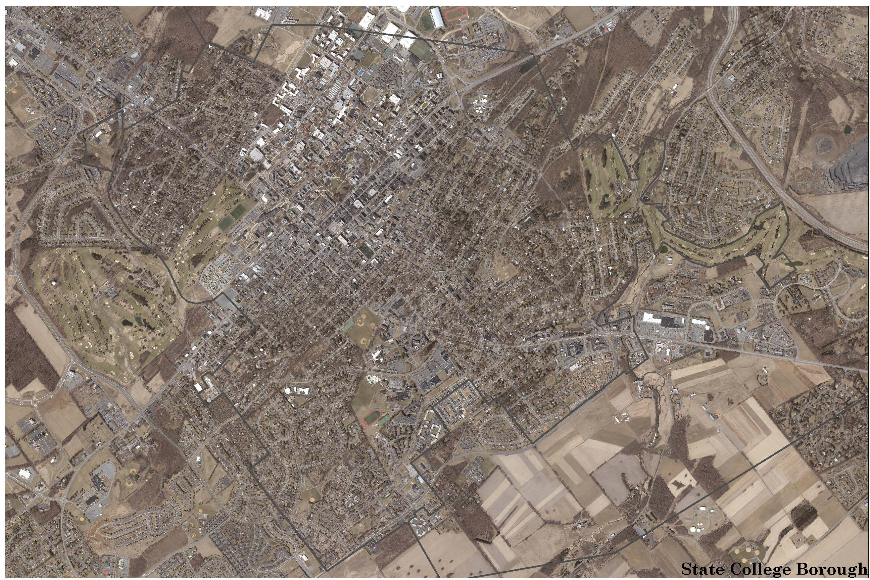
Ferguson Township
Active Transportation Plan and Long Range Transportation Plan
Notes:
Introduce
Thank you for being a part of this workshop today.
To begin, I would like to give you a little background about who we are and why we are here today...

Slide 2
Major Responsibilities of the CCMPO
Keep up to date with Legislation for Transportation
Keep Stakeholders up to date and Informed
Prepare new plans as needed
Prepare the Long Range Transportation Plan (LRTP) updates
Follow Federal programing for
Transportation Improvement Program (TIP)
12 Year Program (TYP)
Unified Planning Work Program (UPWP)
Allocate Federal, State and Local Capital Project Funds for
Roads
Bridges
Transit
Active Transportation

Slide 3
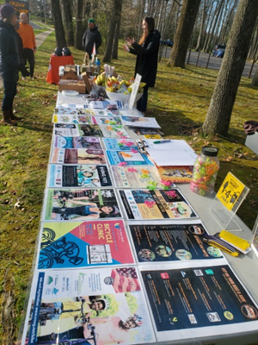
Active Transportation Plan (ATP)
Develop a County wide plan
Data gathering
Recently adopted plans
Analysis
Stakeholder Engagement
Project listing
Implementation

Slide 4
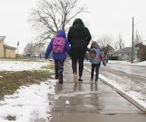
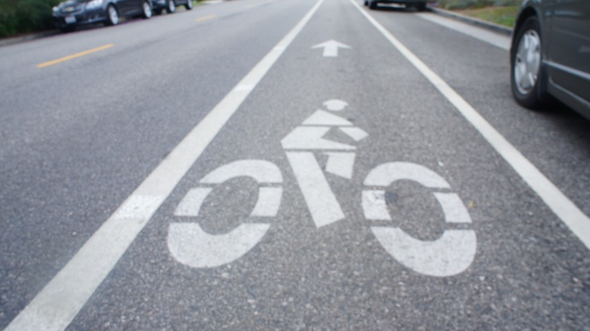
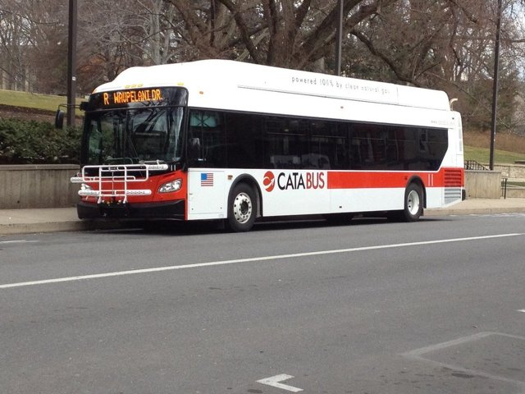
ATP Modes
What would be considered as part of an ATP?
Bicycle
Pedestrian
Public Transit Access
Wheels

Slide 5
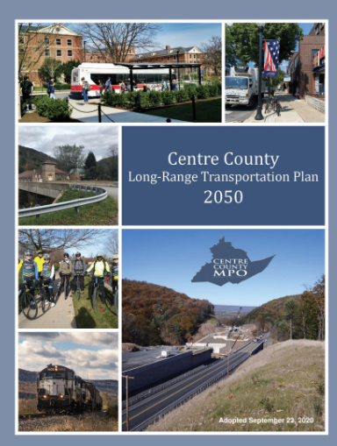
Long Range Transportation Plan (LRTP)
Encompasses all modes of transportation
Incorporates MPO’s goals and objectives
into the proposed transportation system
Evaluates the system based on established
performance measures
Must be a minimum 20 year plan horizon
Must be fiscally constrained

Slide 6
Basics for the LRTP 2055
Research and Data Collection
Demographics
GIS
Bridge Evaluation
Crash Data And Vulnerable Road Users
Stakeholder Input
Equity
Issue Analysis/Project Analysis/Investment Planning
Implementation Packaging/Document & Deliverable Production
Public Review & Comment Period
Adoption of the LRTP 2055 by June 2025

Slide 7
2019 Workshop Topics
Roadways
Alternative Modes
Land Use
Emerging Technologies
County/Regional Issues & Needs

Slide 8
Purpose of Future Engagement
Engage Stakeholders
Federal Planning Factors
Identify ISSUES & NEEDS
Recap State and Local Transportation Infrastructure
Fiscal Constraint
Work to address all modes
Vehicular, bicycle, pedestrian, transit, and Emerging Technology
Safety, Condition and Congestion

Slide 9
Ferguson Township Corridors
What 3 roads/corridors either township or state that continue to be of concern?
What are the known issues for those 3 locations?

Slide 10
Safety
What are the 2 known Locations where safety is a concern?
What are the potential Issues or Impacts on the Transportation System?

Slide 11
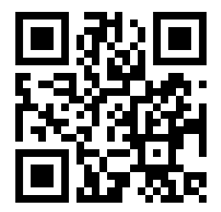
Contact MPO Staff
Centre Regional Planning Agency 814-231-3050
Jim Saylor jsaylor@crcog.net
Anne Messner amessner@crcog.net
Greg Kausch gkausch@crcog.net
Centre County Planning & Community Development Office 814-355-6791
Xochi Confer xtconfer@centrecountypa.gov
Visit us on the web! www.ccmpo.net

