Slide 1
Presentation to the
Ferguson Township
Board of Supervisors
May 2, 2023

Slide 2
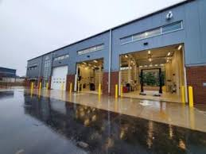
2022 Ferguson Township Programming Usage
24 Board of Supervisors Meetings
16 Planning Commission Meetings
2 Board of Supervisors Budget
Work Sessions
2 Spring Creek Watershed Commission
Meetings
TOTAL of 44 Programs

Slide 3
2022 Ferguson Township Messaging Usage
83 Bulletin Board Messages
Messages are used to advertise meeting agendas, job announcements, ABC vacancies, etc.
Bulletin Board messages are valued as 1/10th of a program
83 Bulletin Board messages = 8.3 “programs”

Slide 4
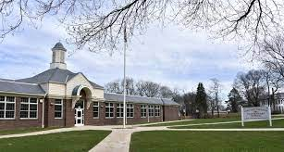
2022 Ferguson Township Programming
44 Programs
+ 8.3 Bulletin Board Messages
52.3 Total Programs in 2021
Ferguson Township sponsored 9.7% of all programming by C-NET members in 2022.
Ferguson Township sponsored 9.5% of all programming by C-NET members in 2021

Slide 5
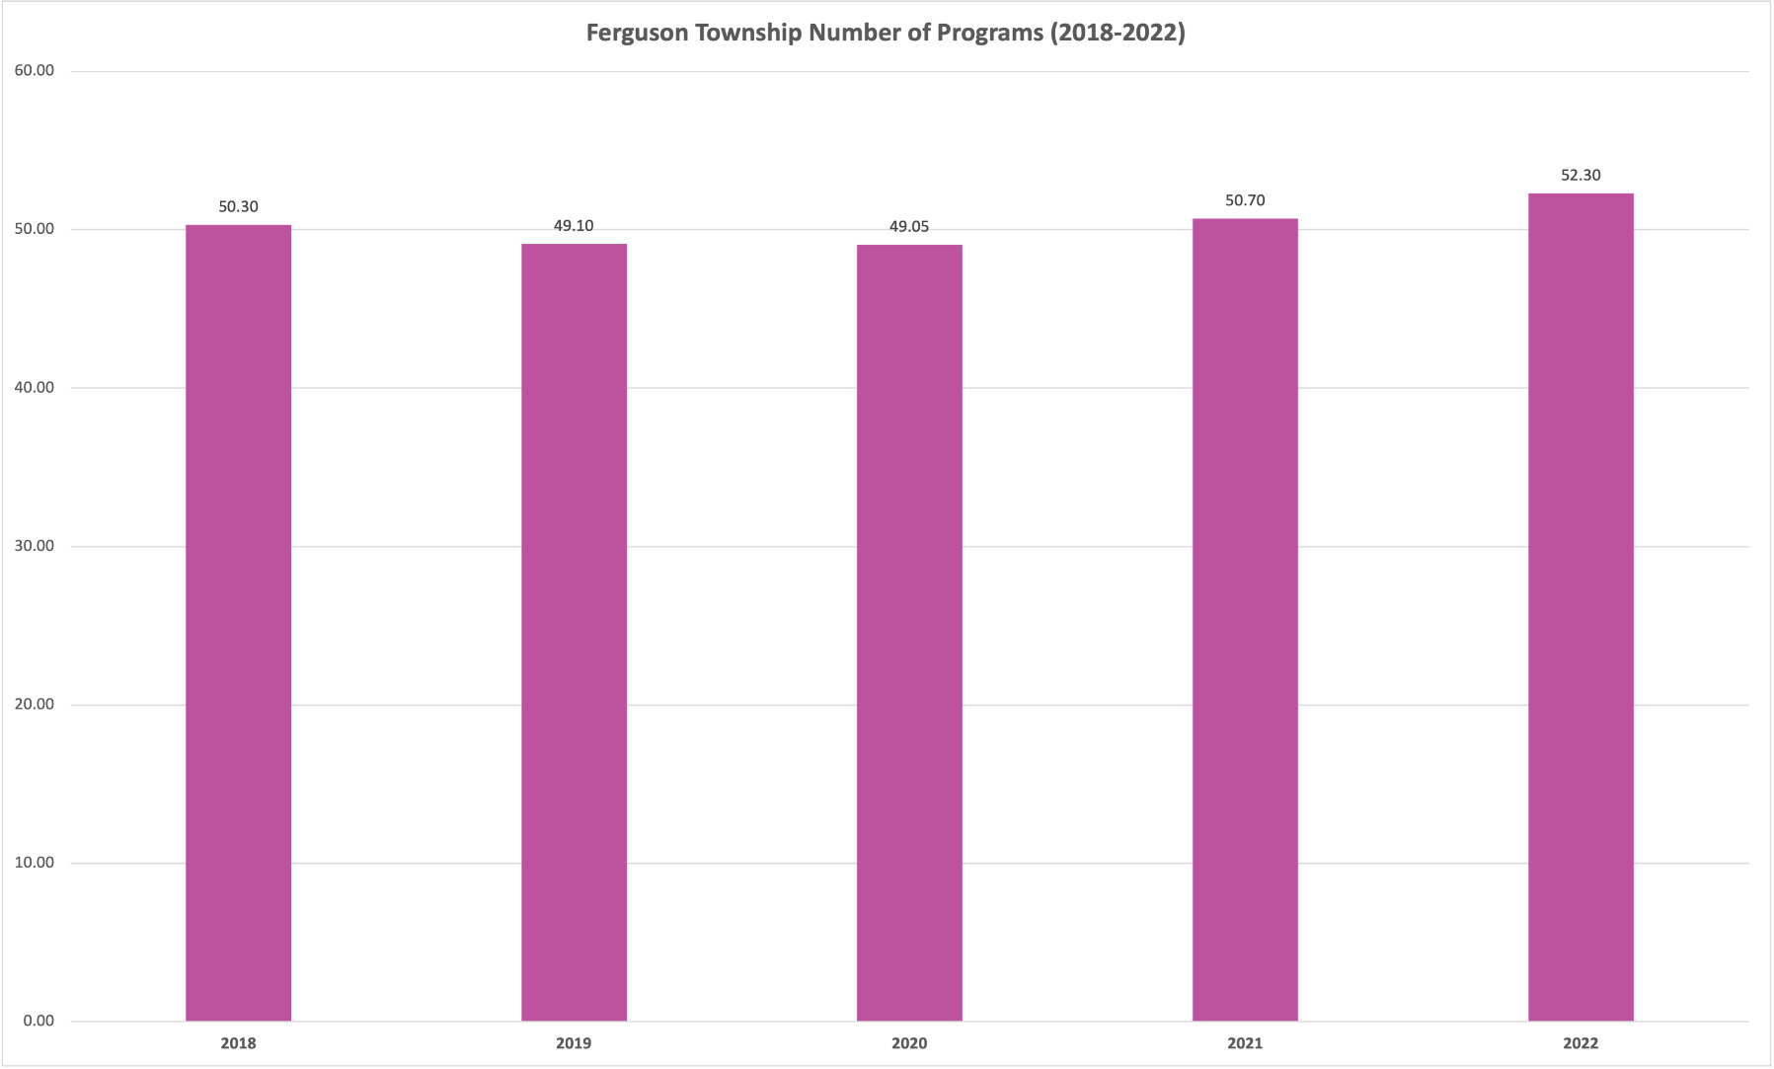
Ferguson Township Programming 2018 - 2022
Notes:
2005 – 591 programs
2006 saw an increase of 99 programs (approximately 17%)

Slide 6
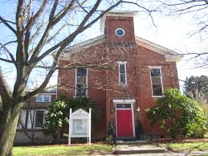
Ferguson Township Programming 2018 - 2022
C-NET’s Funding Formula is based upon a 5-year rolling average – Programming in 2018 – 2022 will determine the Township’s 2024 C-NET “dues”
Ferguson Township sponsored 9.9% of all programming by all C-NET members in
2018 – 2022
Percentage of programming sponsored in 2017 - 2021 = 9.04%

Slide 7
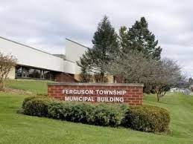
2022 C-NET Highlights
501 Programs produced by C-NET staff in 2022
New Cable Franchises negotiated between Shentel and
Ferguson Township and State College Borough
Franchises with Patton Township, College Township and Harris Township completed in 2023
Franchises with Ferguson Township and State College
Borough includes $5,000 per year in capital funding for
C-NET
Agreement finalized with Penn State in April of 2022
which establishes an annual minimum contribution to
C-NET from the University ($6,000 annual minimum)
Significant staff turnover in August 2022, resulting in a
change in 2 out of 4 full-time positions (both positions were
filled by promoting from within)

Slide 8
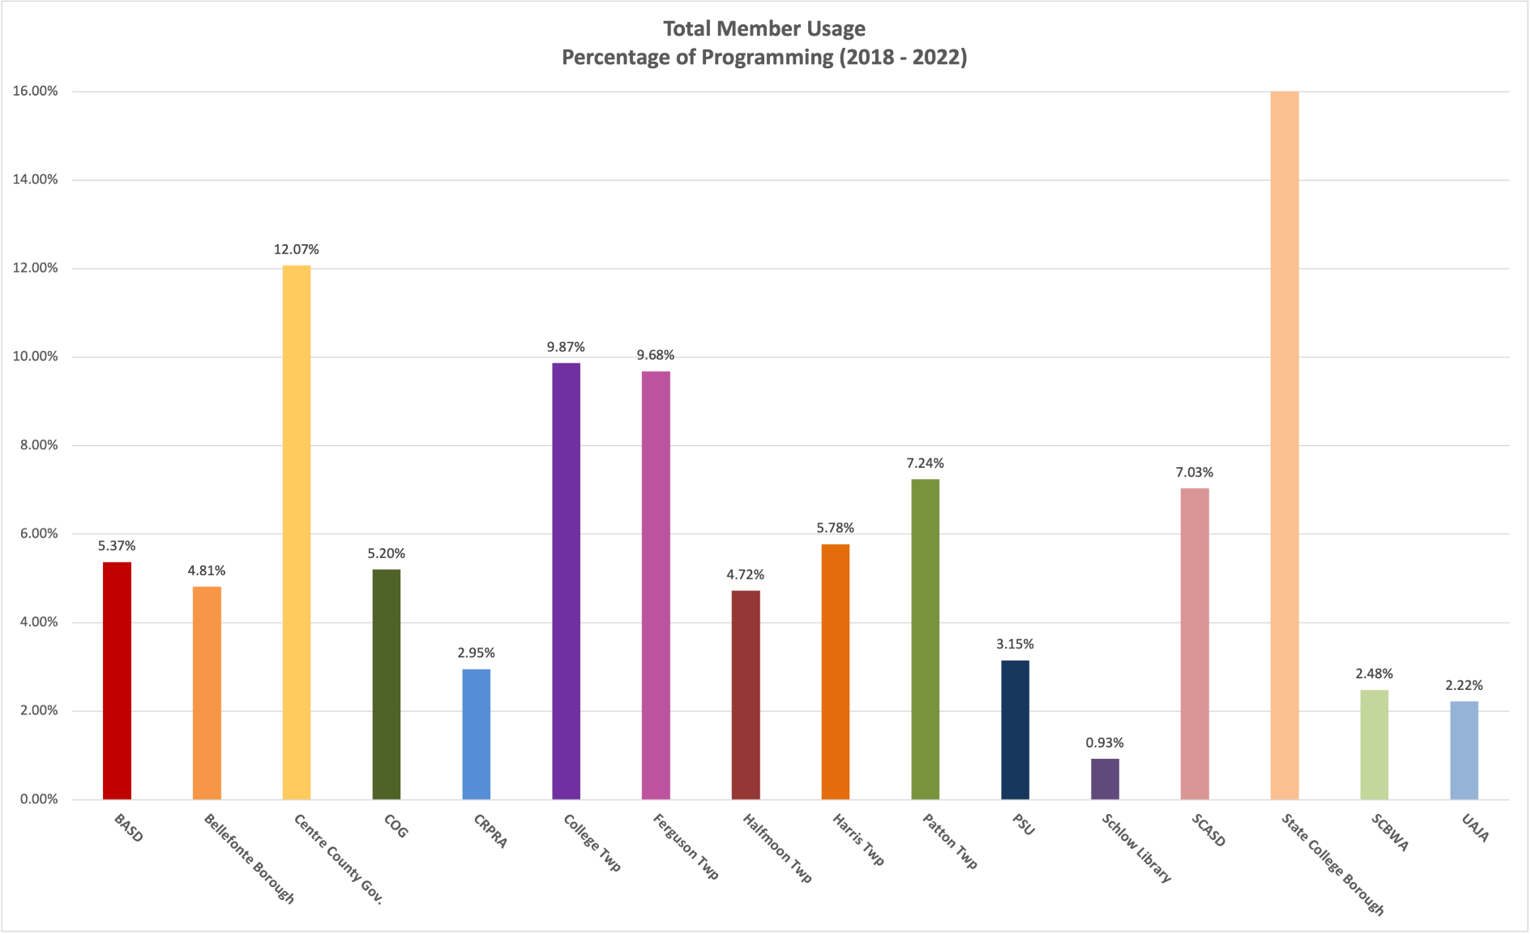
All C-NET Member Programming 2018 - 2022
Notes:
2005 – 591 programs
2006 saw an increase of 99 programs (approximately 17%)

Slide 9
Online Programming Average # of Views
** Keep in mind these are only online views –
cable television viewing data is not available
MEETING | Jan 2022 - March 2023 CNET1.ORG | Jan 2022 – April 2023 - YOUTUBE
FERGUSON TOWNSHIP BOARD OF SUPERVISORS | AVG # = 100.06 | AVG # = 59.15
FERGUSON TOWNSHIP PLANNING COMMISSION | AVG # = 70.19 | N/A

Slide 10
Franchise Basics
Ferguson Township Franchise with Comcast
Franchise was negotiated between Comcast and the 8 municipalities of the Centre Area Cable Consortium
All 8 municipalities have an identical franchise with Comcast
Franchise agreement provides for
Franchise fees to Ferguson Township are equal to 5% of Comcast gross revenue within the Township ($250,421 in 2021 / $253,770.06 in 2022 / increase of 1.3%)
A subscriber pass-through of approximately 32 cents per subscriber per month for C-NET capital needs
Continued access to the Comcast Digital Guide
to display C-NET programming on the Guide

Slide 11
Franchise Basics
Ferguson Township Franchise with Shentel
Franchise was negotiated between Shentel, Ferguson Township, and State College Borough
The two franchises are identical
Franchise agreement provides for
Franchise fees to Ferguson Township are equal to 5% of gross revenue within the Township (No customers anticipated until perhaps 2024)
A lump sum capital grant to C-NET of $5,000 annually. Once subscriber pass-through revenue exceeds $5,000, the capital grant will change over to a subscriber pass-through.
Continued access to the Comcast Digital Guide
to display C-NET programming on the Guide

Slide 12
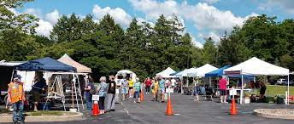
How and Where to Watch
C-NET Channel 7
Tuesday night Board of Supervisors’ meetings are
televised at the following times:
LIVE Tuesday at 7:00 pm
Thursday at 9:00 am
Friday at 6:00 am
Saturday at 12:00 am
Board of Supervisors’ meetings are Streamed LIVE on YouTube (CNETCentreCounty)
Planning Commission meetings are televised at the same times on alternate weeks

Slide 13
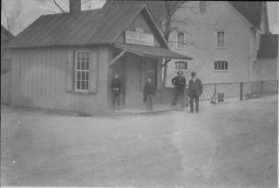
How and Where to Watch
C-NET1.org
ALL C-NET programs are available to view Online, OnDemand at cnet1.org.
Meetings are generally online within 48 hours of recording, often sooner
Meetings are “chaptered” by agenda items
Meetings remain available online for a minimum of 12 months

Slide 14
How and Where to Watch
Roku Set-Top Box or Streaming Stick
Set-Top Box
Streaming Stick

Slide 15
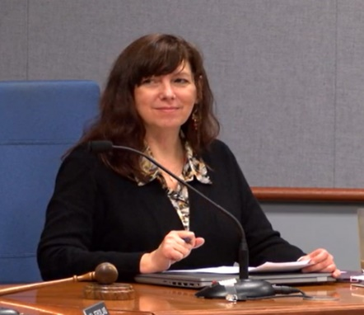
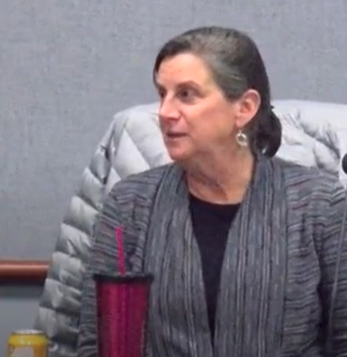
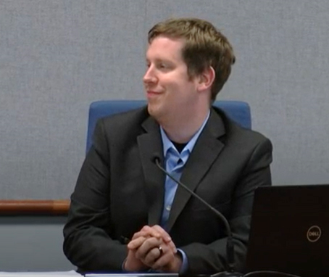
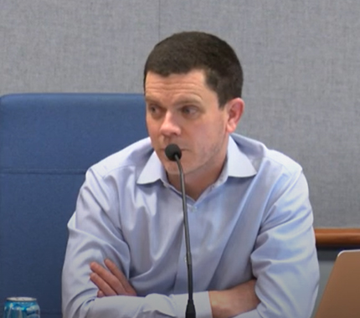
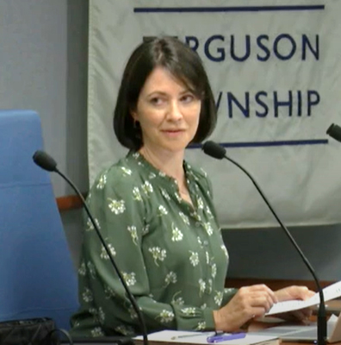
Help Us Help You
Avoid leaning back too far away from your mic
Make sure that your microphone is directly in line with your mouth
Insist that all presenters and speakers come to and remain at the podium to speak

Slide 16
