Slide 1
Centre Area Transportation Authority
System Overview

Slide 3
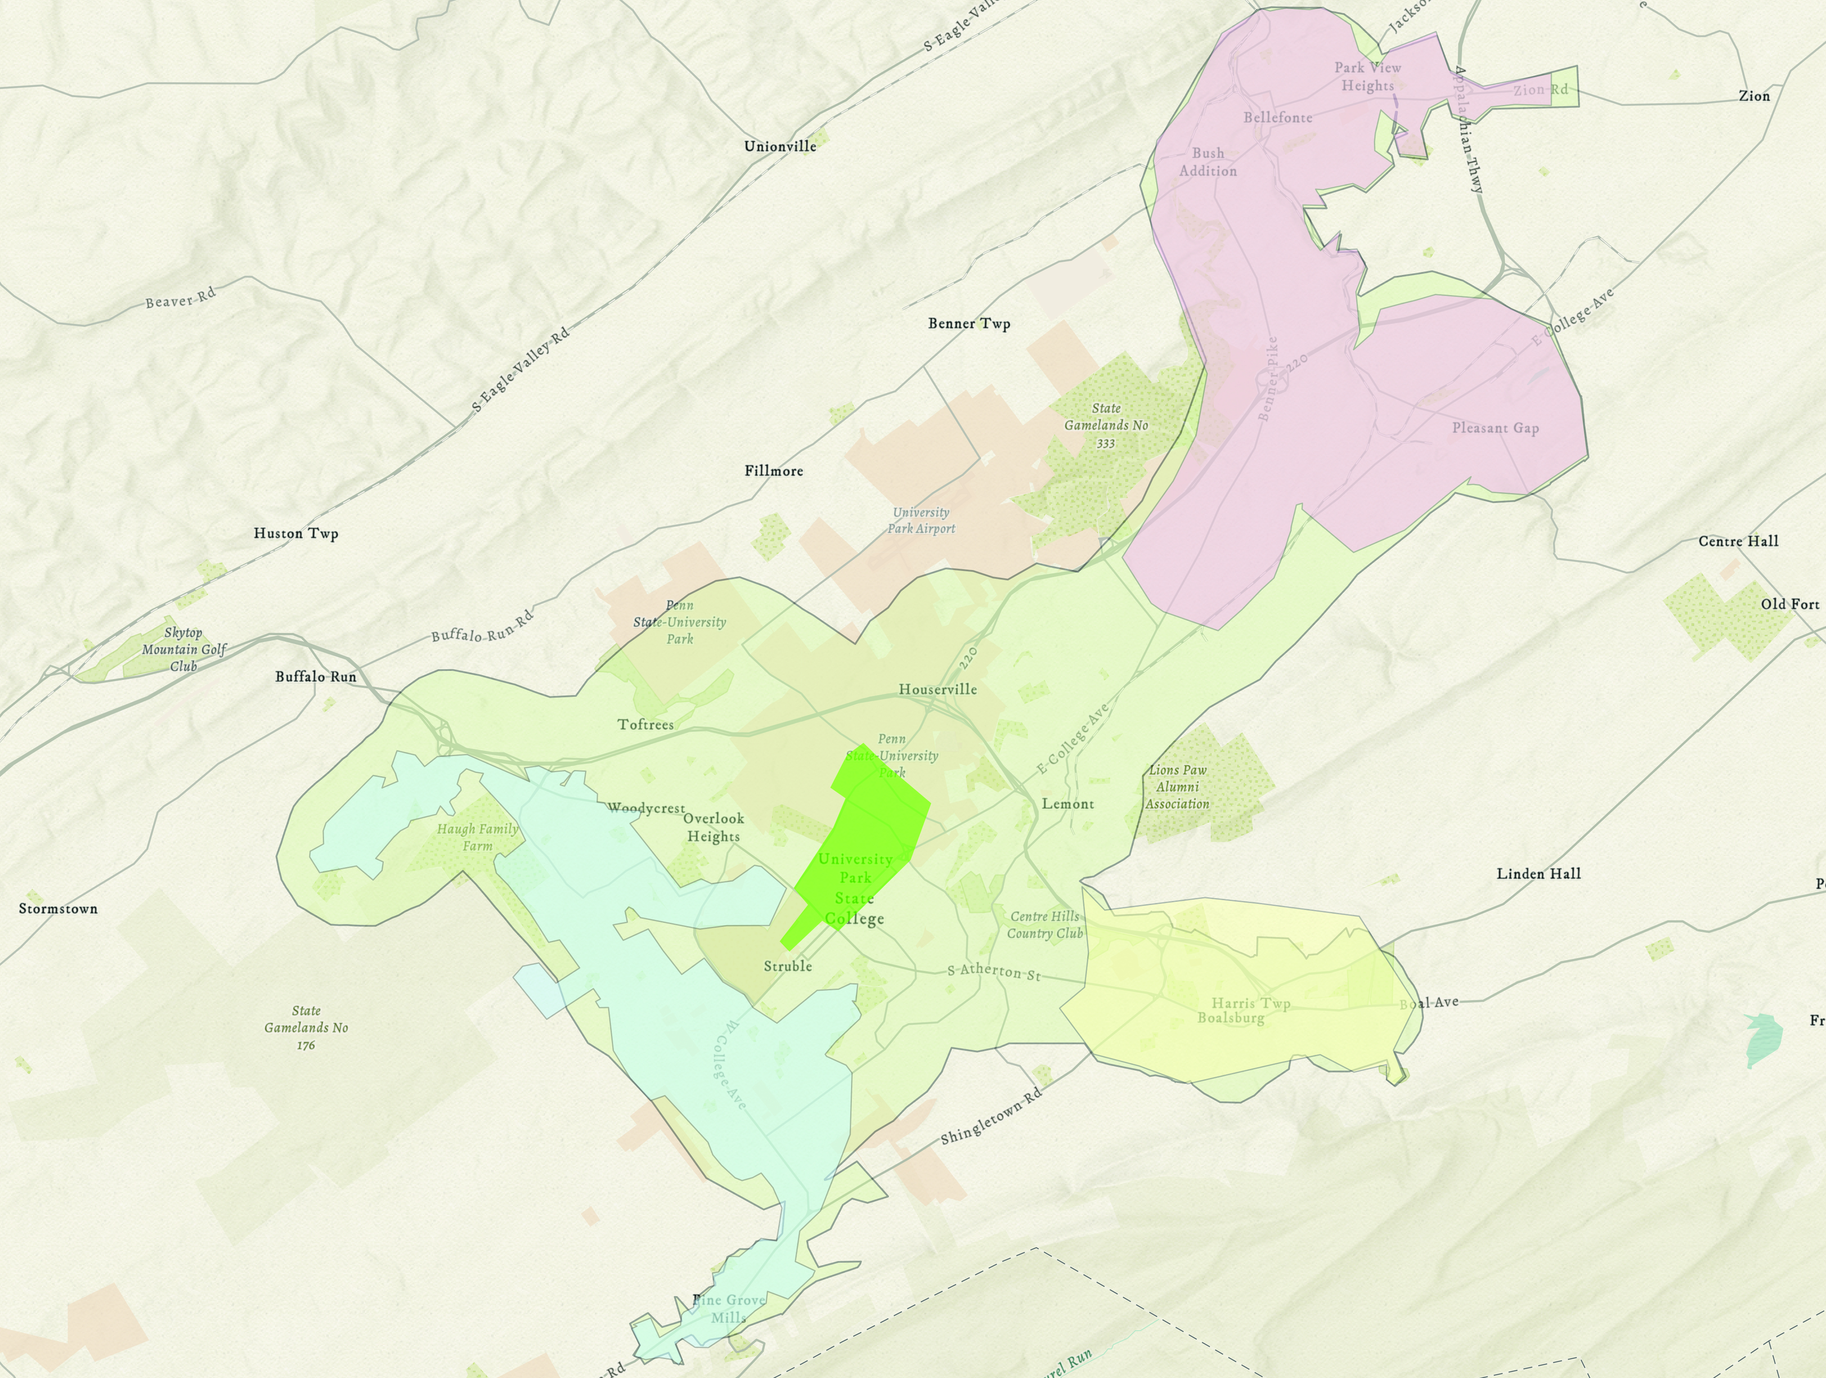
CATA's SERVICE AREA

Slide 4
WHAT IS TRANSIT WORTH?
Our Role in the Community​
Direct and indirect benefits
Roadways
Climate​
Transit Dependent riders​
Choice Riders​
Event Support
...It's the System Overall

Slide 5
CATA’S SERVICE PLANNING PRINCIPLES
Address local and Centre Region travel needs; a single, connected network.​
Build a system serving community destinations even if not optimally efficient.​
Maximize revenue from choice rider services.​
Ensure all services are functionally accessible for passengers with disabilities.​
Optimize frequency
Operationally link all of our services (fixed route, demand response, commuter).​
Select the lowest-cost service option to meet demand.

Slide 6
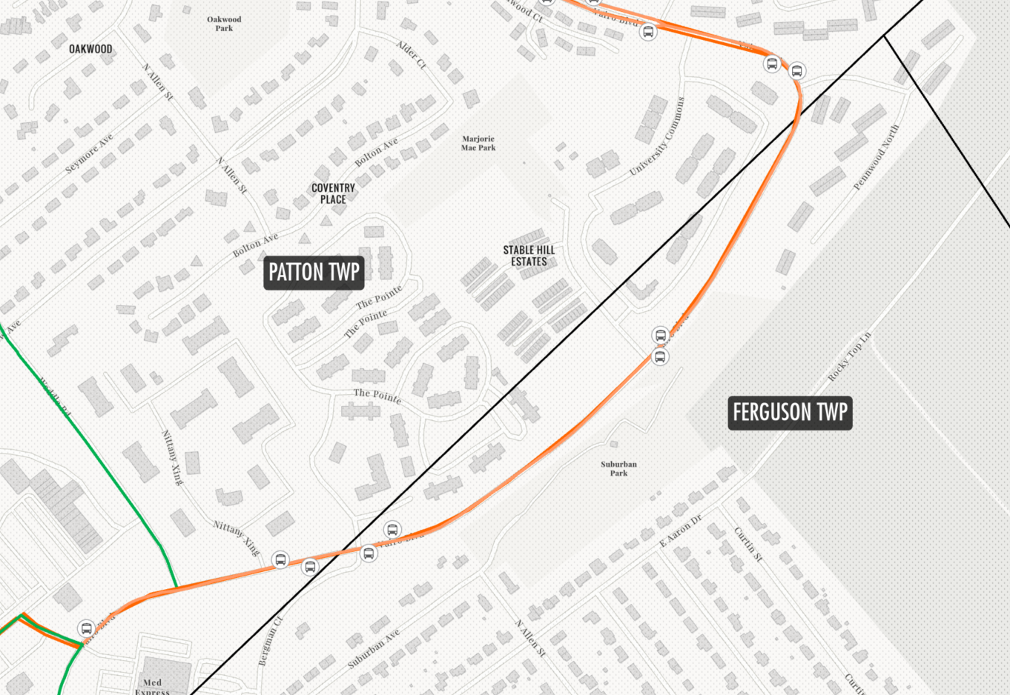
Counting rides by township is not so easy...

Slide 7
REGULATORY FRAMEWORK
Public service planning requirements (public visibility and involvement)​
Cannot compete with the private sector​
All services must be accessible (ADA)​
Standardized data collection and reporting (FTA, PennDOT)​
A bevy of State/Federal employment, safety, purchasing, and equity regulations

Slide 8
CATA RIDERSHIP FY 2023

Slide 9
CATA'S RIDERSHIP TRENDS

Slide 10
CATA’s Fiscal year 2023/24 proposed BUDGET
Expenses $25,793,558
Revenue Breakdown
CATA’s Cost Per Revenue Hour

Slide 11
FEDERAL OPERATING ASSISTANCE
5307 Capital Funding ~$2-2.5 million annually​
Systems with <100 vehicles in any mode may use this as Operating assistance​
Based on the population of the service area and population density​
5307 Small Transit Intensive Cities (STIC) additional assistance ~$3.3-3.5 million​
Based on service levels and efficiencies in 6 categories of fixed route service​
CATA is the only small PA system that meets all 6

Slide 12
STATE OPERATING ASSISTANCE
PA Act 44 Funding Operating Assistance ​
Sources: Turnpike, PTAF, Bond Funds, Lottery, Motor Vehicle Licenses​
Allocated by state (“black box” process) based on ​section 1513.c
Never less than the prior year​
Consider: ridership, Seniors, Revenue Miles and Hours, and CATA 5-year targets​
Increases based on the money available and PennDOT determination​
Notified ~ March each year​
Local Match requirement Default 15%

Slide 13
MEMBER VS. CONTRACT
Members:​
Seat on the Board​
Legal Control of Authority​
Legal obligation to fund Authority​
Contract:​
Pay for levels of service provided

Slide 14
BUDGET CALENDAR
Service planning changes September
Local Match estimate October
Preliminary budget January
Refine service changes February
Finalize Local Match/Final proposed budget March
Board review April
Public input/Final budget approval May

